Slide 1




Student Stream Selection
PRESENTATION

Slide 2
Introduction
• This project focuses on predicting the suitable academic stream for students.
• Uses machine learning models trained on student academic records (10th, 12th, JEE, CUET).
• Provides guidance for students’ career choices through data-driven predictions.
• Deployed as a user-friendly application using Streamlit for real-time usage.

Slide 3
Objectives
• To analyze student academic data and entrance exam performance.
• To preprocess and clean raw data for better prediction accuracy.
• To apply and compare ML models (Logistic Regression, SVM, Random Forest).
• To evaluate models using accuracy, confusion matrix, and classification reports.
• To deploy the final model into a web-based application for easy access.

Slide 4
Tools and Technologies Used
• Programming Language: Python
• Libraries: Pandas, NumPy, Matplotlib, Seaborn, Scikit-learn, Joblib
• ML Models: Logistic Regression, SVM, Random Forest
• Deployment Tool: Streamlit
• Visualization: Matplotlib, Seaborn
• Platform: VS Code, Streamlit Web App

Slide 5
Methodology
Data Collection :
From student academic records.
Data Cleaning :
Handling missing values, removing outliers.
Feature Engineering :
Derived features like JEE_100, CUET_100, Acad_Avg, Entrance_Avg.
Exploratory Data Analysis :
Feature importance and correlation heatmap.
Model Training :
Logistic Regression, SVM, and Random Forest.

Slide 6
Model Training and Evaluation
• Dataset was split into 80% training and 20% testing sets.
• Logistic Regression, SVM (RBF Kernel), and Random Forest models were trained.
• Accuracy, precision, recall, and F1-score were calculated.
• Confusion matrices were plotted for model performance comparison.
• Random Forest achieved the best accuracy and was selected as the final model.

Slide 7
Streamlit App
• Developed a simple and attractive web interface.
• Students enter Name, Age, Gender, City, Marks (10th, 12th, JEE, CUET).
• Predict button generates suitable stream prediction.
• Prediction result is shown in a styled output card.
• Saves user inputs and predictions into a CSV file for future analysis.
• Easy-to-use tool for students and educational institutions.

Slide 8
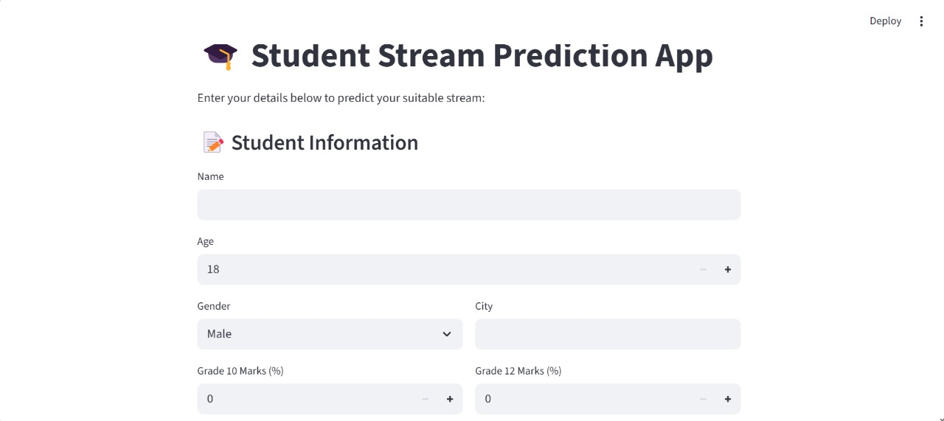
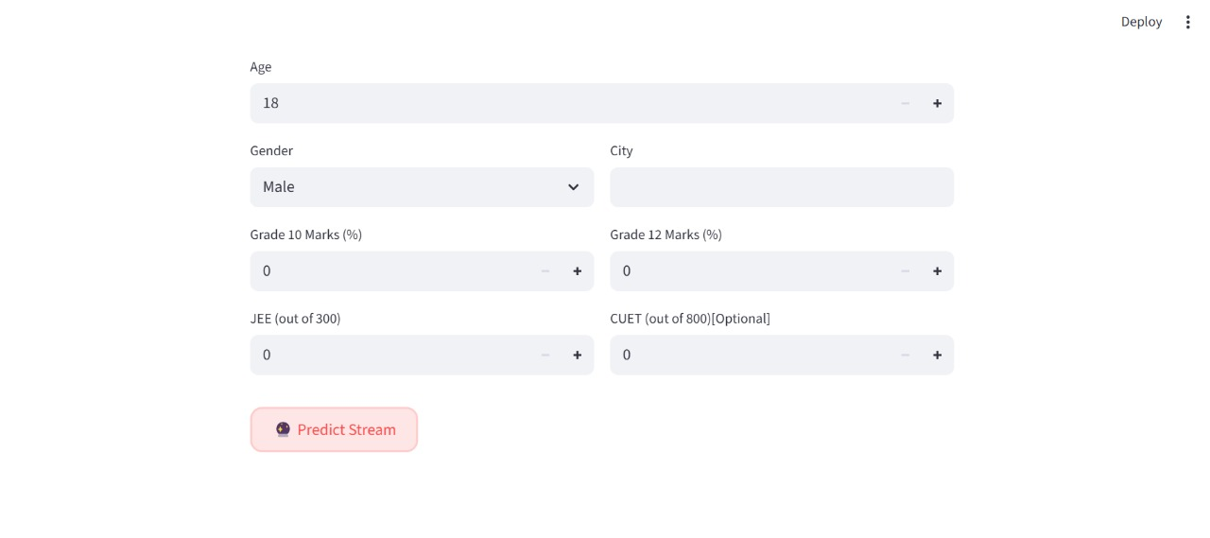
Development: UI Screenshot

Slide 9
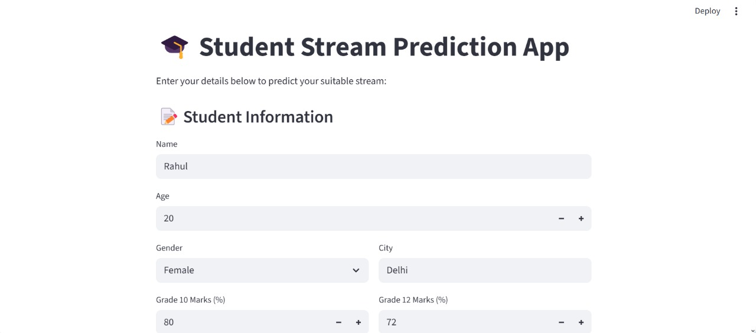
Output (with Sample Input)

Slide 10
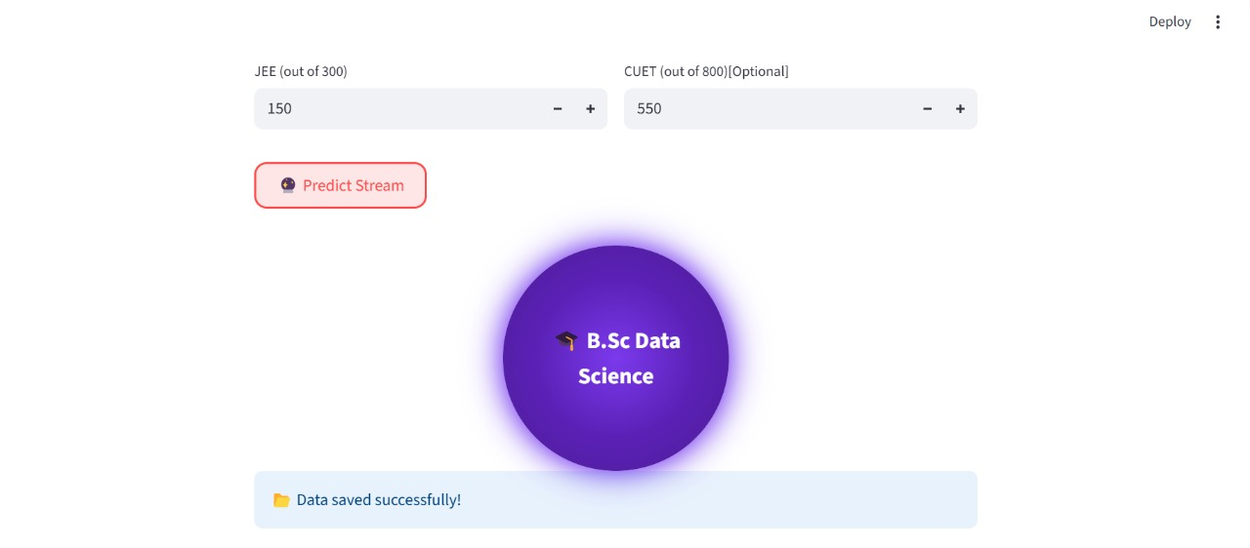
Output (with Sample Input)

Slide 11
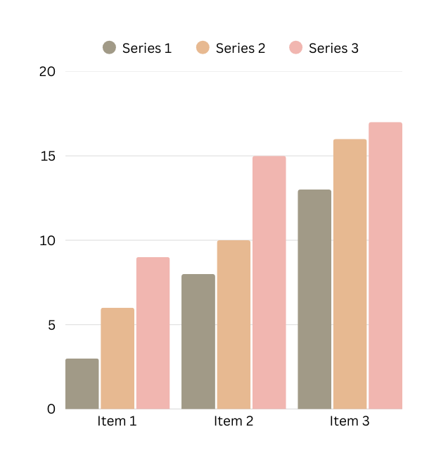
Result
• Random Forest outperformed Logistic Regression and SVM in accuracy.
• Final model retrained on the complete dataset for better generalization.
• Saved as 'model.pkl' for deployment.
• Predictions include academic stream recommendations based on input.
• Achieved an interactive, accurate, and practical prediction system.

Slide 12
Future Scope
• Incorporate psychometric and interest-based attributes.
• Explore deep learning models for higher accuracy.
• Cloud deployment for scalability and real-time access.
• Expand to provide career path suggestions along with stream prediction.

Slide 13
Conclusion
• Built a reliable machine learning-based Student Stream Prediction System.
• Data preprocessing and feature engineering significantly improved accuracy.
• Random Forest emerged as the most effective model.
• Streamlit deployment made the system interactive and user-friendly.
• Demonstrates the importance of data-driven decision-making in education.

Slide 14
Thank You
Presented By - Diya Tilwani – 6002
Rahi Ghodke – 6012
Rishita Shah – 6021

